Slide 1
Stockholm Business School
Welcome to SBS!
1 Sep 2025
Head of Stockholm Business School Fredrik Nordin – Welcome!
Director of Studies Lovisa Näslund – What are academic studies?
Academic Advisors – Practical information and support
International Coordinator – Study abroad
The Business Association – Student influence
Fadderiet
The presentation will be posted on:
www.sbs.su.se/education/new-student

Slide 2
Lovisa Näslund
Director of Studies
studierektor@sbs.su.se
Stockholm Business School

Slide 3
Stockholm Business School
Research Sections
Management
Marketing
Accounting
Finance
Support
Academic Advisors
Course coordinators
Director of Studies office
International Coordinators
Teaching Assistants

Slide 4


What is ”business administration” about?
ACTIVITIES
If the value of output > value of input → Created value!
Management
Marketing
Accounting
Finance
Knowledge about organisations

Slide 5
Why business administration?
Understand how businesses and other organisations work
Understand what should be done and how
Skills and knowledge:
Learning how to manage, market and finance production of goods and services
The ability to structure your thought:
Analysing complex information and complex problems.
→ Academic education

Slide 6


How to go about it? https://athena.itslearning.com/
Series of courses (typically 5 weeks)
  Teaching (Lectures, seminars, etc)
  Course literature
  Examination (exams, group assignments, etc)
Who does what?
Course director: teaches and leads the course
Examiner: Examines it (usually the course director)
Course coordinator: Registration and admin
Teaching Assistant: Teaching support
Notes:
My presentation is a good example of the bilingual nature of many of our courses, the course literature is in English and the language of instruction in Swedish.

Slide 7
How do courses work?
Intended learning outcomes – this is what you are meant to learn in this course.
Help on the way: Teaching, course literature etc.
Did you reach the goal? Examination tests how far you got.
Examination
  Most courses have more than one type of examination, which are weighted to final course points (1-100). The points translate to a grade.
  Mandatory examinations and other elements have to be passed in order to pass the course
  The syllabus stipulates how the course is examined, and what the mandatories are that have to be achieved in order to pass the course

Slide 8
Grading System
A, B, C, D & E = Passing grades
F & Fx = Failing grades
Seven-point criterion-related grading scale
A = | 90–100 course points | E = | 50–59
B = | 80–89 | Fx = | 45–49
C = | 70–79 | F = | 0–44
D = | 60–69
Grading scale
Review of grades
Grade decisions cannot be appealed, but you can request a review

Slide 9
Course information? 3 important documents!
1. Syllabus (Kursplan)
Legally binding document containing intended learning outcomes, assessment tasks, requirements for passing the course
2. Study guide
  Instructions, course material, and practicalities, reading material
3. Schedule
  Time and place for teaching and examination
Athena
  Everything
Course web page
  Course literature list, syllabus, contacts

Slide 10
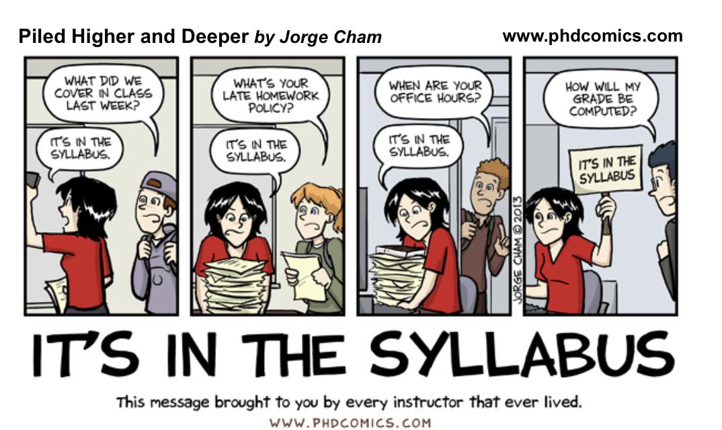
Notes:
These are typical questions asked by students and the how teachers respond. You turn to me as director of studies when there is something wrong with the syllabus, or when incidents in the course do not correspond to the syllabus.

Slide 11
Code of Conduct
An academic approach and way of acting are a vital part of good scientific practice and cornerstones of all higher education. Stockholm Business School (SBS) has developed a code of conduct for how students are expected to approach their studies and behave towards peers, teachers, administrative staff and as representatives of Stockholm University.
https://www.su.se/stockholm-business-school/education/during-your-studies

Slide 12
As a student at SBS, you are expected to:
Value academic integrity, apply good research practice, independence, scientific methods, accuracy in the implementation of individual work, group projects and degree theses.
Contribute to a well-functioning and respectful collaboration with your peers in joint assignments.
Refrain from cheating in examinations, for example plagiarism, cooperating when it is not allowed, or using aids without special permission.
Work for a safe, tolerant, open-minded and inclusive study and work environment for students and staff, free from discrimination, abusive behavior and harassment.
Affirm people’s equal value, rights, opportunities and obligations, regardless of gender identity or expression, ethnicity, religion or other belief, functional variation, sexual orientation and age.
Take responsibility for arriving on time for scheduled teaching.
Refrain from recording, filming and photographing educational situations. Respect that material recorded by SBS may not be published on websites or in social media.

Slide 13
Cheating
The Higher Education Ordinance (Chapter 10, Section 1) states that disciplinary measures may be invoked against students who use prohibited aids or other methods to attempt to deceive during examinations or other forms of assessment of study performance.
Stockholm University takes cheating very seriously. By cheating is meant, for example, that students cooperate in an unauthorized manner, bring or use unauthorized aids (e.g. notes or mobile phones) or otherwise try to mislead during examination. Plagiarism is also a form of cheating and means that students in an exam use their own (self-plagiarism) or others’ (humans’ or machines’) texts and ideas without correctly referencing these sources; or students paraphrase, that is to say, inadequately rewrites one’s own or another's text.

Slide 14
Cheating
At SBS a text comparison tool is used to check the authenticity of all texts that are submitted for examination.
SBS reports every incident where there is a well-founded suspicion of cheating to the Office of the President. The legal counsels then investigate the matter further and decide whether it should be referred to the Disciplinary Committee.
The Disciplinary Committee may decide to take no further action in the matter, issue an official warning, or temporarily suspend the student from his or her studies up to six months.

Slide 15
How to avoid plagiarism?
Study different referencing systems and chose one you feel the most comfortable with, e.g. Harvard, APA, Oxford.
Make sure you know how to accurately use in-text references in the body of your texts
Ensure you cite sources correctly AND always use quotation marks AND include page number(s)
When re-phrasing a source, use your own words as far as possible, without losing the content of the source used
Construct a correct and exhaustive list of references

Slide 16
Academic Advisors
Bachelor´s level:
Anna Lönnberg: Bachelor's Programmes and courses in Business Administration taught in Swedish
Malin Thunholm: Bachelor's programmes and courses in Business Aministration taught in English. Bachelor's programmes and courses in Advertising and PR taught in Swedish
Master´s level:
Linda Kjellman: Master's programmes and SSES Courses
Charlotte Lindén Ahmad: Master's programmes and SSES Courses

Slide 17
Ladok
Register for courses during the registration period
Register for examinations
Find reported grades
Print official transcripts of your study results and registrations, etc.
Apply for credit transfer
Apply for your degree upon completion
You log in with your university account:
www.student.ladok.se
Make sure you have the correct e-mail address in Ladok.

Slide 18
Athena
Athena is Stockholm Business School´s learning platform:
Here you will find your schedule, syllabus, course material, literature and assignments.
In Athena you register for a seminar group when required.

Slide 19
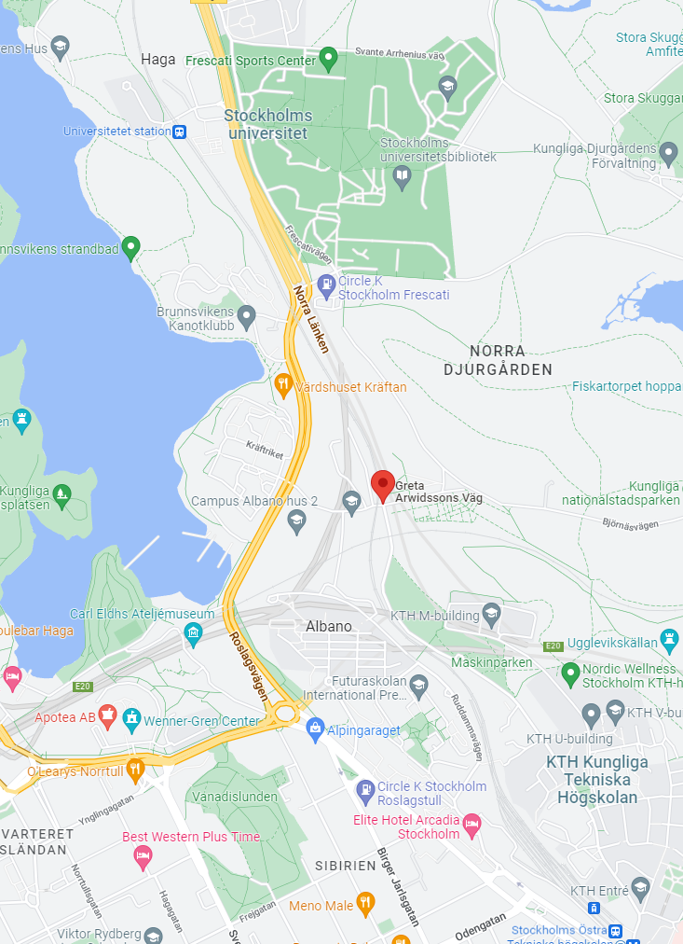
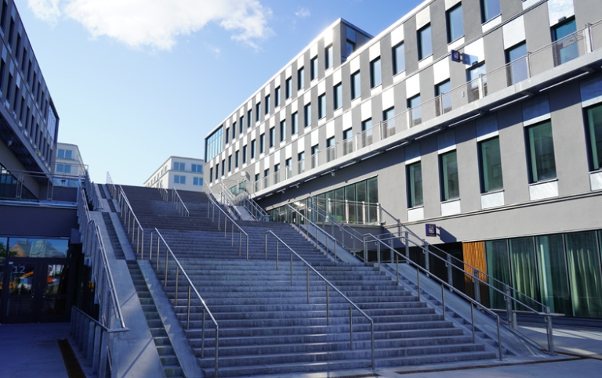
Find Campus Albano
Building 2:
Lecture and seminar rooms, study places and restaurant
Address: Albanovägen 18
Other entrances in the building
Greta Arwidssons Väg 8 och 10
Aula
Magna
Campus
Albano

Slide 20
Manage your studies successfully
Your responsibility, get started right away!
Take part in lectures and seminars even if it is not compulsory
Approach the teachers, ask about things you don't understand
Examples of good study techniques:
Before cours start: Read the Study Guide
Before the lecture: Read the course literature about what will be covered
During lecture: Take notes
After the lecture: Summarize course literature and lecture notes, briefly
with models and technical terms
Repeat your notes for the exam
Remember to bring your ID to the exam!

Slide 21
Course personnel
Head of course: Main responsible teacher and examiner for the course
Teacher: Teaches and assesses exams and assignments
Teaching assistants (Amanuens): Answer course-related questions, handles re-assessment. (It is not possible to appeal a grade, but it is possible to request a re-assessment if you believe that there was an incorrect assessment.)
Course coordinator: Handles course administration in Athena and Ladok. Reporting grades, re-registration, seminar group registration.

Slide 22
Academic Advisors
Applications and admission, different requirements and prerequisites, course offering and choice of courses, degree requirements, etc.
We aim to empower you as students to make well-founded decisions concerning your studies. We have professional secrecy.
Phone hours Tuesdays-Thursdays (9.30-11.00).
Meetings in person or via Zoom. Building 2, floor 6 at Albano.
Contact via e-mail bachelor@sbs.su.se; masterprogrammes@sbs.su.se
https://www.su.se/stockholm-business-school/education/contact

Slide 23
Educational support
As an enrolled student with a documented disability you can apply for educational support in connection with your studies at Stockholm University.
Submit an application via NAIS system. Attach documentation verifying that you have a disability.
A coordinator at SU will contact you to set up a meeting.
Afterwards you will receive a NAIS certificate including recommended adjustments.
E-mail a copy to SBS studentstod@sbs.su.se
https://www.su.se/english/education/student-support/studying-with-a-disability/apply-for-support-as-a-swedish-citizen-1.609229

Slide 24
Academic Writing services
Academic Writing services at Stockholm University help to develop your academic writing and study skills.
Individual consultation
Presentations
Seminars
Writing groups
https://www.su.se/english/education/student-support/academic-writing-service

Slide 25
Stockholm Student Health Services
Being a student can be stressful and worrying at times and it may cause a impact on your well-being and on your studies.
Stockholm Student Health Services offer support during your study time.
Phone consultation and questions regarding your wellbeing and study situation on Thursdays.
Online booking system. Make an physical appointment with a health and lifestyle counsellor. New appointments the following week, released on Fridays.
Lunch break yoga online.
www.su.se/english/education/student-health

Slide 26
Exchange studies through SBS
WHEN can you study abroad?
In the 5th semester of your Bachelor’s programme
In the 3th semester of your Master’s programme
After completion of Introduction to Business and Global Business studies for students taking Free Standing Courses
WHEN can you apply for exchange studies?
in the beginning of the 4th semester of your Bachelor’s programme
in the beginning of the 2nd semester of your Master’s programme

Slide 27
Study Abroad Website
https://www.su.se/stockholm-business-school/education/study-abroad
Contact: international@sbs.su.se

Slide 28
Finally…
Bachelor program students must apply for next semester at www.universityadmission.se between September 15th – October 15th.
And fulfill the requirement; 15 credits from semester 1.
Keep your contact information updated!

Slide 29


